Slide 1
Mapping the Educational Landscape
Comprehensive Data Analytics Study of Engineering Colleges in India
Tools Used: Python & Power BI
Presented By:
Charitha Akula

Slide 2
Introduction
Purpose of the Project:
Provide a data-driven overview of India’s engineering education system.
Objectives:
Collect and analyze college data (ratings, fees, domains, locations).
Visualize insights using Python & Power BI.
Support students, parents, and policymakers in decision-making.
Scope:
Covers engineering colleges listed on Careers.360.com, across all states and domains.

Slide 3
Tools & Technologies
Programming: Python(3.x).
Libraries: BeautifulSoup, Requests, Pandas, NumPy, Matplotlib.
Visualization: Power BI (Dashboards & KPIs).
Data Source: Careers360.com
Storage: CSV (careers360_colleges.csv).

Slide 4
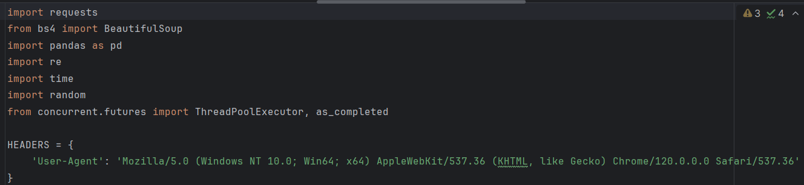
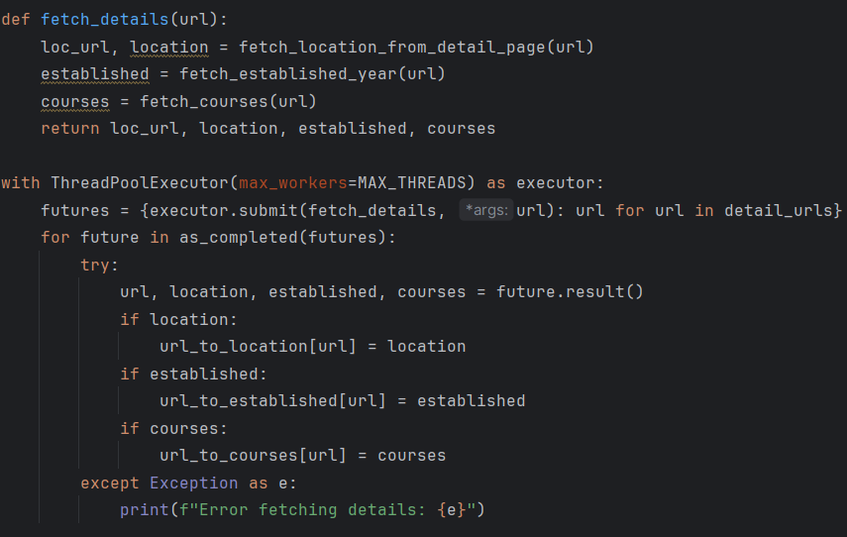
Data Collection ( Web Scrapping)
Source: Careers360 – Engineering, MBA, Medical, Law colleges
Method:
Requests + BeautifulSoup for HTML extraction
Multi-threaded scraping using ThreadPoolExecutor
Data Extracted:
College Name, Location (City/State), Rating, Fee, Course Details

Slide 5
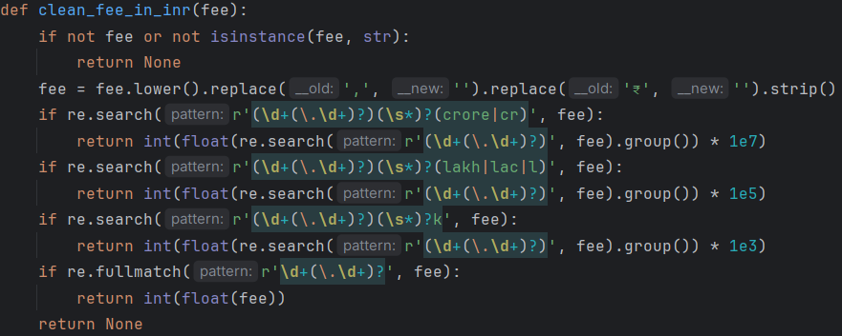
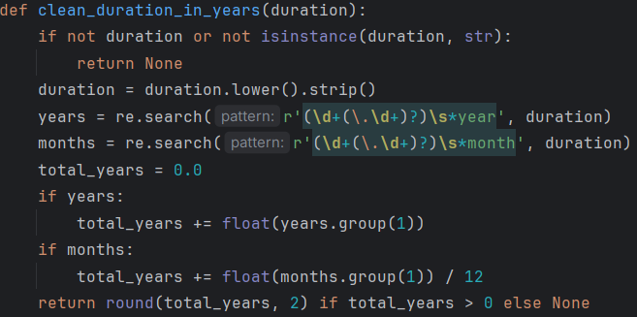
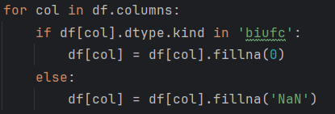
Data Cleaning & Preparation
Techniques Used: Pandas, NumPy, Regular Expressions (re).
Steps:
Handled Missing Values.
Converted Fees (Lakh/Crore) -> Numeric INR.
Extracted numeric ratings and course durations (in years).

Slide 6
Outputs:
Raw data -> careers360_colleges.csv.
Cleaned dataset ready for visualization

Slide 7
Exploratory Data Analysis (Python)
Visualizations Created:
KPI Summary (Total Colleges, Avg Rating, Avg Fee).
Domain Distribution (Donut Chart).
State & College Rankings (Bar Charts).
Fee vs Rating (Scatter), Trends (Line Chart).
Tools: NumPy & Matplotlib.

Slide 8
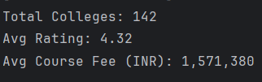
KPI Summary
Insights:
Dataset includes hundreds of colleges across India.
Average Rating: 3.8/5 -> Strong academic quality.
Average Fee: ₹1.2-₹1.5 Lakh per year -> moderate affordability.

Slide 9
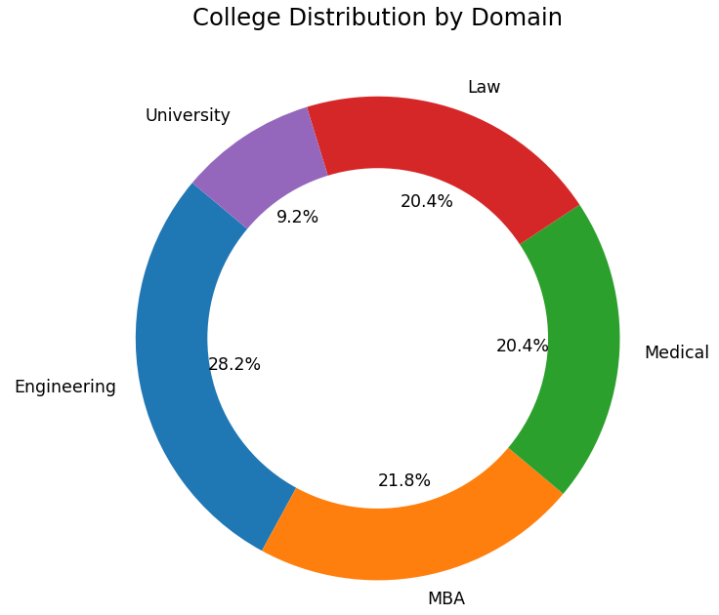
College Distribution by Domain
Insights:
Engineering dominates, followed by MBA and Medical.
Law and University domains have smaller representation.
Confirms that technical education remains India’s core focus.

Slide 10
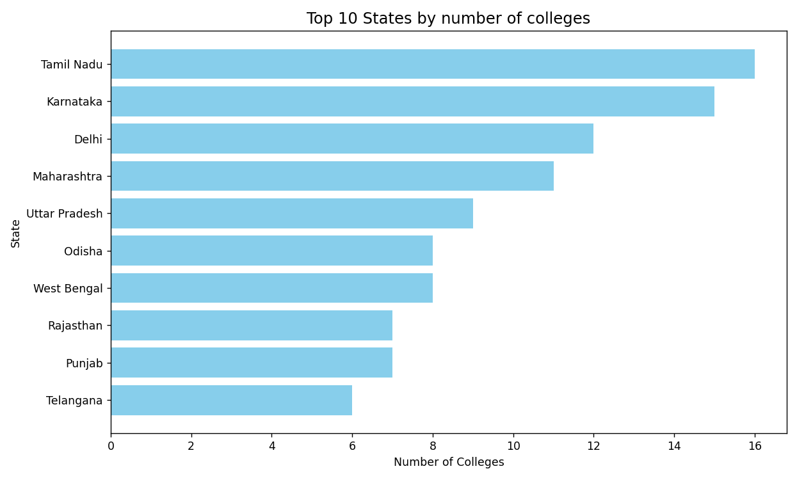
Top 10 States by College Count
Insights:
Maharashtra, Tamil Nadu, Karnataka lead in total colleges.
States with industrial hubs have greater educational presence.
Shows regional concentration in the southern and western zones.

Slide 11
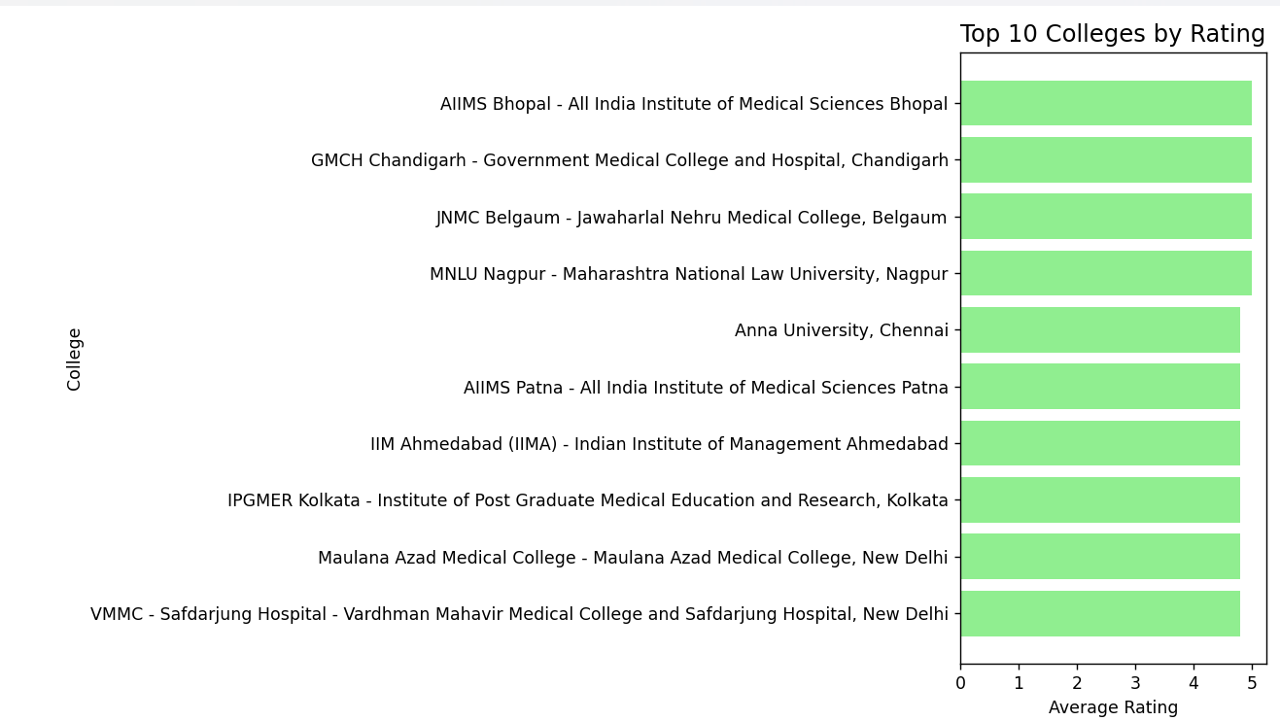
Top 10 Colleges by Rating
Insights:
Top-rated institutes include IITs, NITs, and major private universities.
High ratings indicate strong infrastructure and placement quality.
Helps identify benchmark institutions in the country.

Slide 12
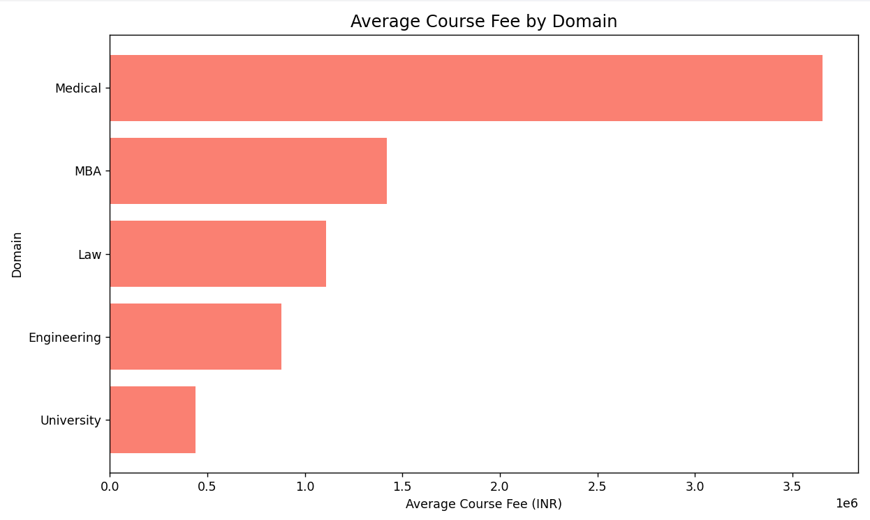
Average Fee by Domain
Insights:
MBA and Medical programs charge the highest fees.
Engineering and Law are relatively affordable.
Reflects differences in infrastructure and specialization costs.

Slide 13
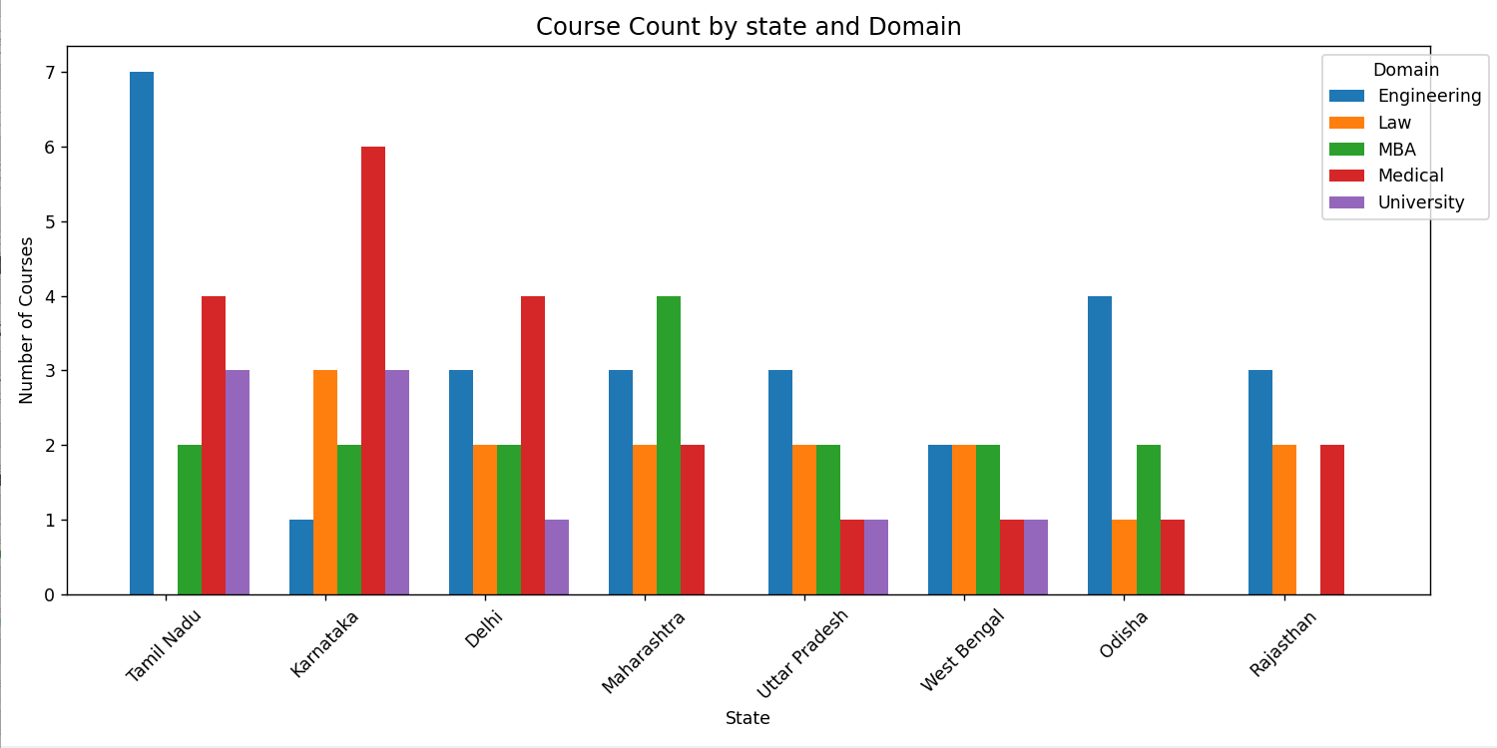
Course Count by State & Domain
Insights:
Maharashtra, Tamil Nadu, and Karnataka offer the most diverse programs.
Engineering dominates in every state; MBA & Medical show regional clusters.
Indicates regional specialization and state-level academic strengths.

Slide 14
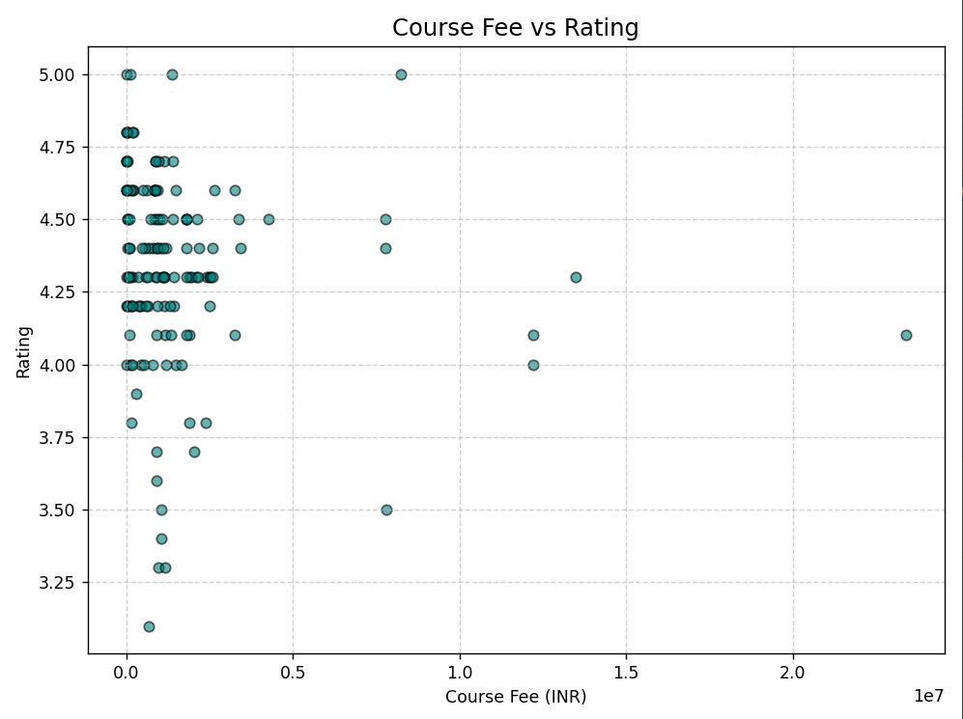
Course Fee vs Rating (Scatter Plot)
Insights:
No direct correlation between fee and rating.
Some low-fee government colleges maintain high ratings.
Proves higher cost ≠ better quality.

Slide 15
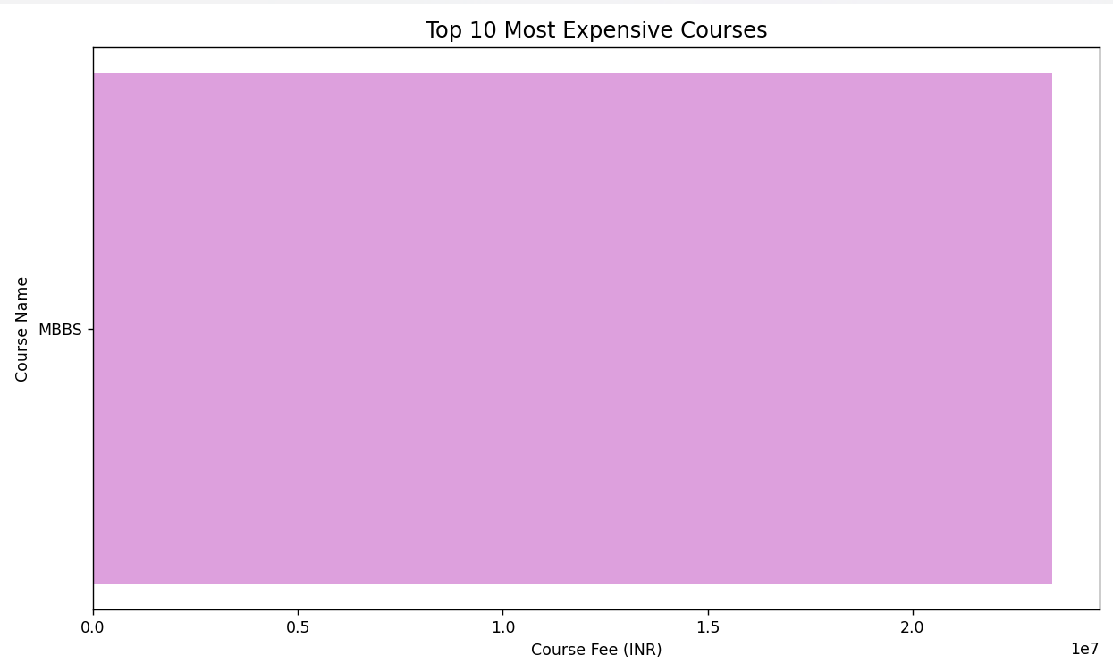
Top 10 Most Expensive Courses
Insights:
Mostly MBA and Medical programs with ₹10-₹20 lakh fees.
Offered primarily by private universities.
Indicates clear cost disparity with government colleges.

Slide 16
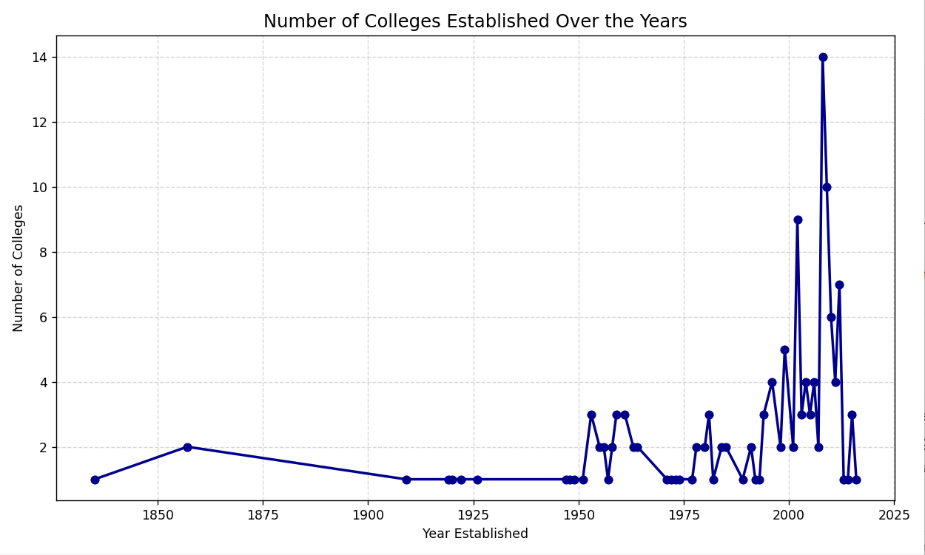
Colleges Established Over the Years
Insights:
Strong growth between 1980 and 2010 in college establishments.
Plateau after 2015 -> saturation or stricter regulations.
Reflects stabilization in the higher education landscape.

Slide 17
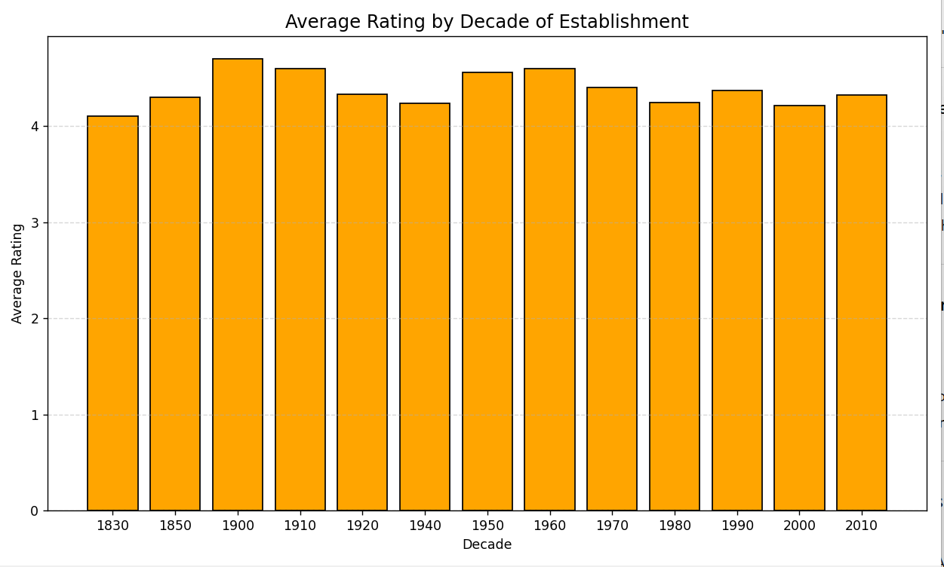
Average Rating by Decade
Insights:
Colleges from the 1990s-2000s hold the highest ratings.
Older institutions maintain quality via experience & reputation.
Newer colleges are still establishing credibility.

Slide 18
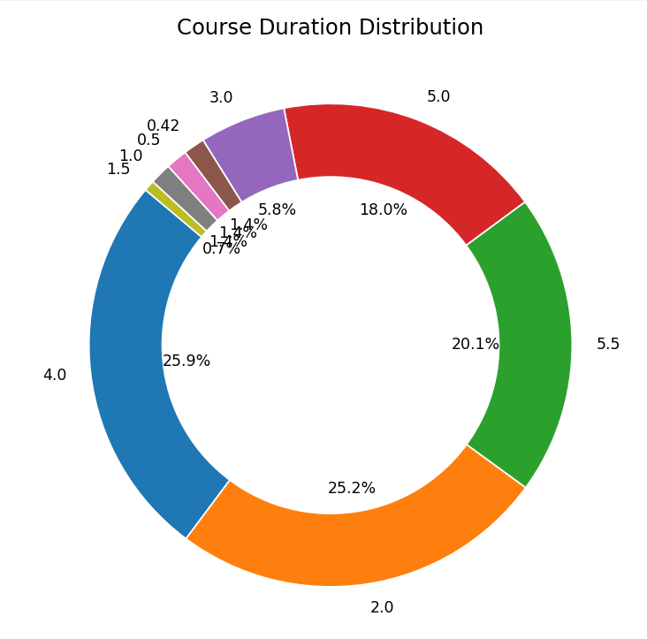
Course Duration Distribution
Insights:
Majority of courses last 4 years (B. Tech programs).
2-year programs correspond to M. Tech or MBA.
Indicates undergraduate dominance in Indian education.

Slide 19
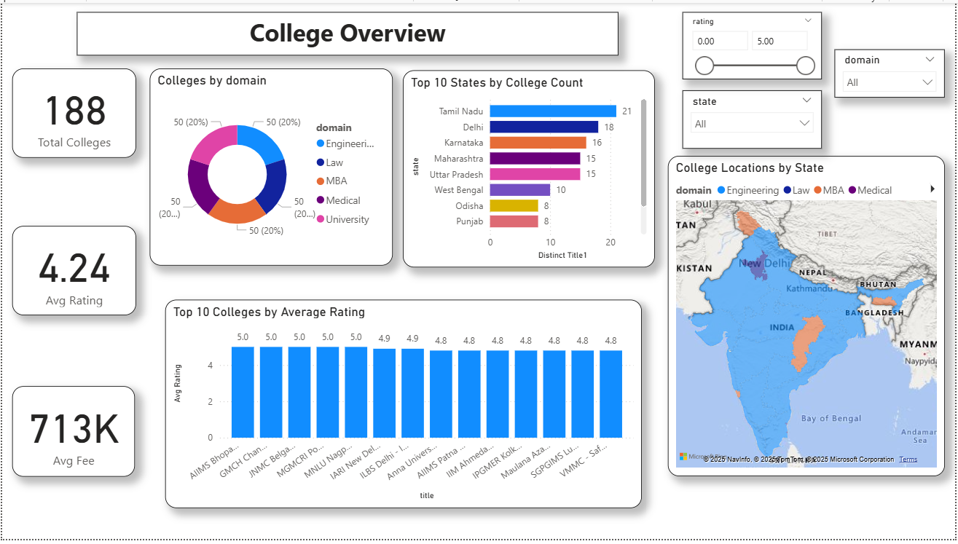
Power BI Dashboards
Dashboard 1: KPIs, Donut (Domain), Top States, Top Colleges, Map.

Slide 20
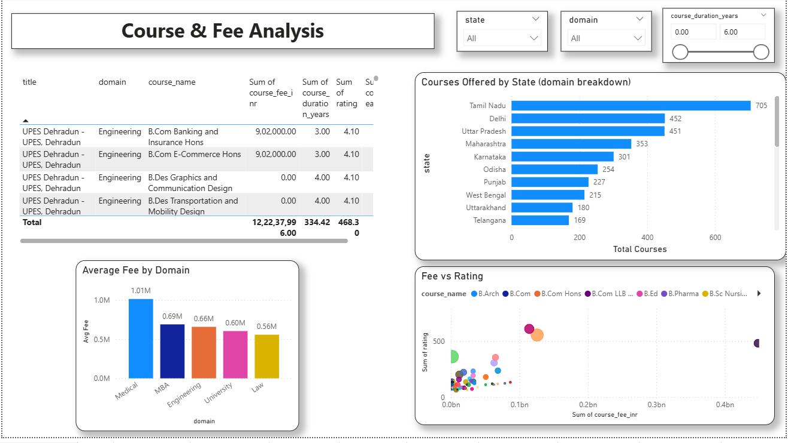
Dashboard 2: Table, Fee vs Rating, Avg Fee by Domain, Courses by State.

Slide 21
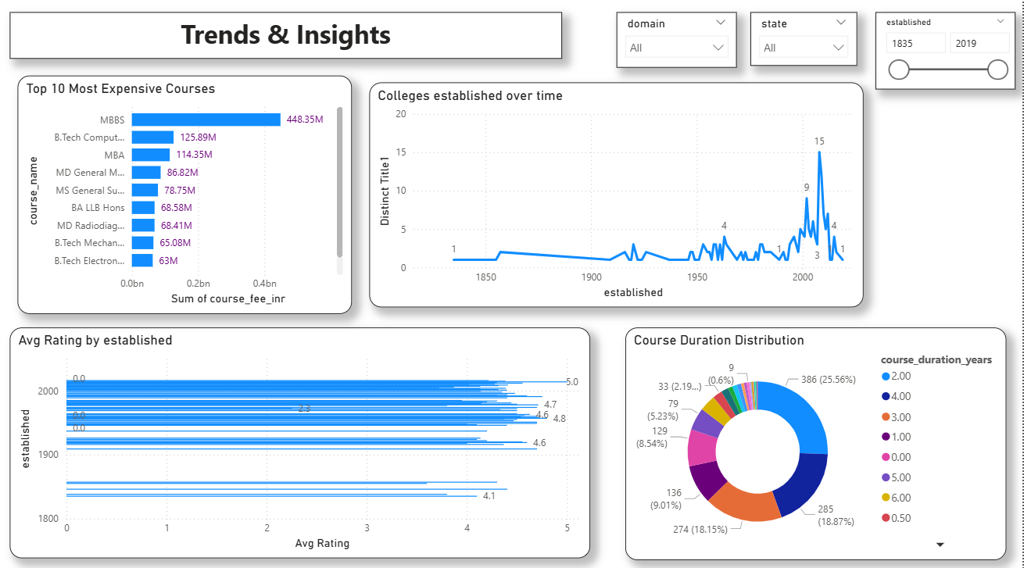
Dashboard 3: Expensive Courses, Establishment Trend, Duration Distribution.

Slide 22
Results & Findings
Top States : Maharashtra, Tamil Nadu, Karnataka, UP.
Avg Rating: 3.8.
Avg Fee: ₹1.2 - ₹1.5 Lakh
Private colleges dominate; most courses are 4- year B. Tech
Challenges & Limitations
Frequent website structure changes disrupt scraping.
Rate limits restrict data collection speed.
Missing data may impact Power Bi visuals.

Slide 23
Conclusion & Recommendations
Successfully mapped India’s engineering education landscape.
Provided insights into college quality, cost, and spread.
Recommend extending scraping to include placement & infrastructure data.
Future Scope
Automate scraping via Airflow or Cron jobs.
Include international institutions for comparison.
Use ML models to predict ratings or fee ranges.

